Slide 1


Social Buzz

Slide 2


Today's agenda
Project recap
Problem
The Analytics team
Process
Insights
Summary

Slide 3

Social Buzz is a fast growing technology unicorn that need to adapt quickly to it's global scale. Accenture has begun a 3 month POC focusing on these tasks:
An audit of Social Buzz's big data practice
Recommendations for a successful IPO
Analysis to find Social Buzz's top 5 most popular categories of content
Project Recap

Slide 4


Problem
Over 100000 posts per day 36,500,000 pieces of content per year!
But how to capitalize on it when there is so much?
Analysis to find Social Buzz's top 5 most popular categories of content

Slide 5



Andrew Fleming
Chief Technical Architect
The Analytics team
Marcus Rompton Senior Principle
Samarjith M N
Data Analyst

Slide 6
Process
1
Data Understanding
2
Data Cleaning
3
Data Modeling
4
Data Analysis & Visualization
5
Uncover the Insights

Slide 7

Insights
16
1897
May
Unique
Categories
Reactions to “Animal” Posts
Month with Most Posts

Slide 8
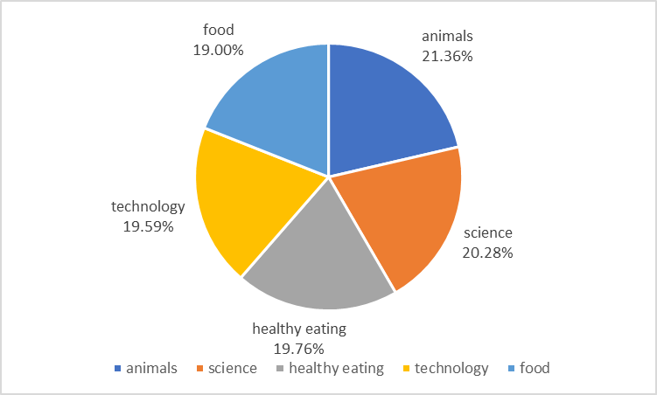

Slide 9
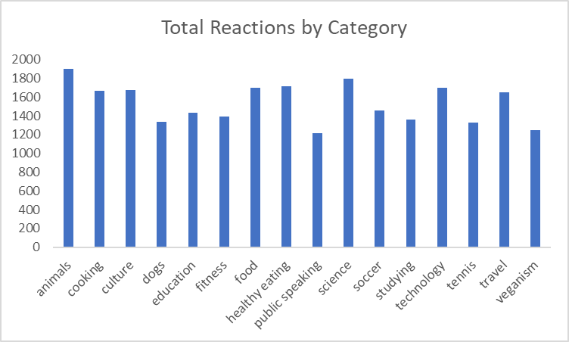

Slide 10
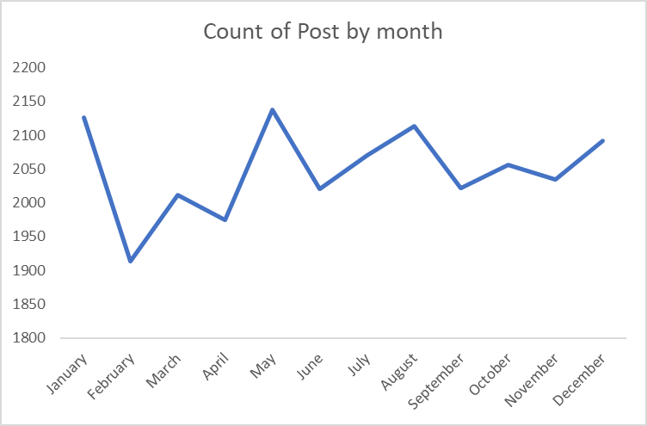

Slide 11

Unique Categories: I've analyzed the data and found that there are a total of 16 unique categories.
Reactions to the Most Popular Category: The most popular category on the platform has garnered significant attention, with a total of 1897 reactions.
Month with the Most Posts: Upon examining the posting patterns, it appears that May had the highest number of posts.
Summary

Slide 12

Thank you!
ANY QUESTIONS?

